Slide 1
Visual Analytics– Mental Models and Visual Perception
Dr. Ab Mosca (they/them)
Slides based off slides courtesy of Jordan Crouser (https://jcrouser.github.io/)

Slide 2
Plan for Today
Mental Models
What is perception?
How does it work?
Pre-attentive processing
Perceptual problems
Estimating magnitude
Note: I’m going to flash a bunch of slides quickly today. If that doesn’t work for you, you are welcome to step out, close your eyes, etc.. (none of us will be offended and I will fill you in on anything crucial you missed!)

Slide 3

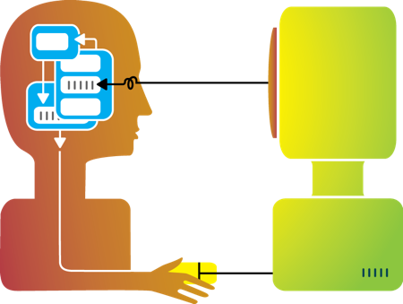
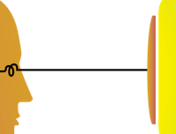

Visualization
Visualization helps shape mental models

Slide 4
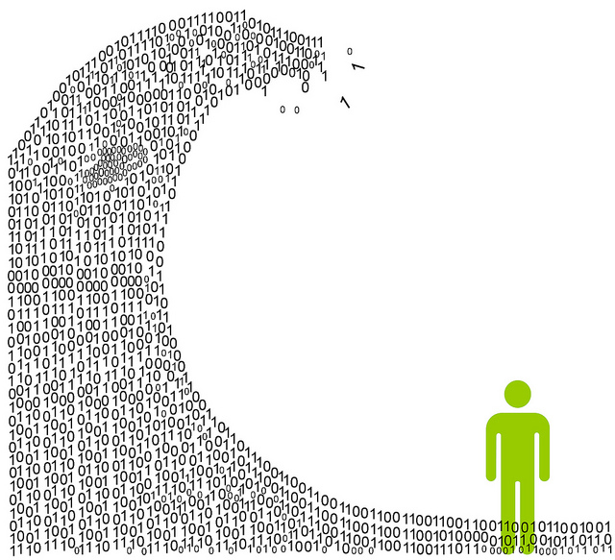
We are exposed to huge amounts of information all the time
So much, in fact, that we can’t process it all fast enough
Information overload

Slide 5

To cope, we construct mental models: abstracted, simplified versions of the world that are more manageable
Mental models

Slide 6

Task 1: Connect all 9 dots using only straight lines
The 9-dot problem

Slide 7
Task 2: Connect all 9 dots using 4 straight lines
The 9-dot problem

Slide 8
Task 3: Connect all 9 dots using 3 straight lines
The 9-dot problem

Slide 9
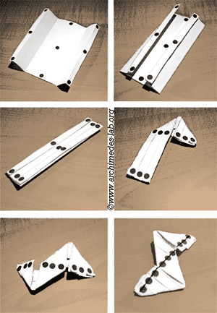
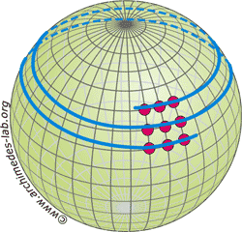
Task 4: Connect all 9 dots using 1 straight line
The 9-dot problem
Notes:
Well, what if I conceptualize my dots on a globe?
What if they're on a piece of paper I can fold?
These are examples of mental models -- how we individually conceptualize something

Slide 10



Mental Models: a Sketch
Notes:
There's the world that exists
We have five senses for understanding the world around us
Our brains use to senses and (automatically) construct a sketch of the work

Slide 11
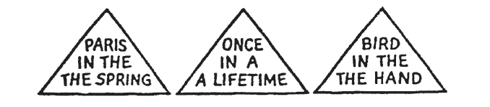
1. We tend to see what we expect to see
Mental models are built from prior experience
We expect new input to “fit” the existing model
Updates are expensive: given input that almost fits, we’ll distort information to avoid re-fitting the model
Expectation is at least as strong as perception
Mental Models
Notes:
Notes of mental models
- Did you see the extra words the first time? Or did your brain edit them out?

Slide 12
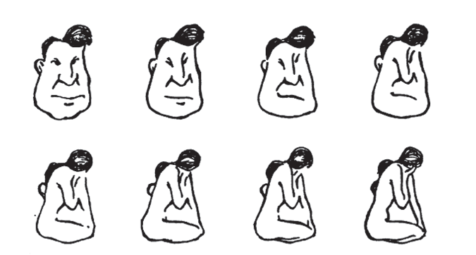
2. Mental models form quickly, & update slowly
“First impressions matter”
Early information can have the highest impact
The order in which we present pieces of information can shape how a person understands the whole
Once a mental model is formed, it takes effort to alter it
Mental Models

Slide 13
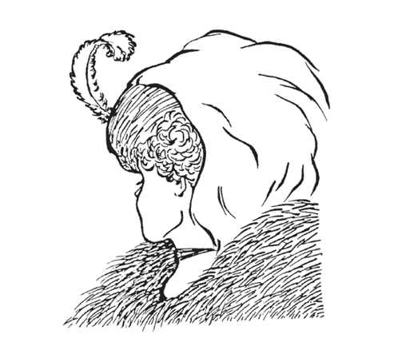
3. New information gets incorporated into the existing model
Integrating competing perspectives is challenging
Switching between multiple perspectives is also difficult (visually or mentally)
Tricky part: real-world problem often require such perspective switching
Mental Models
Notes:
Might see young woman looking away, or an old woman looking to the side

Slide 14




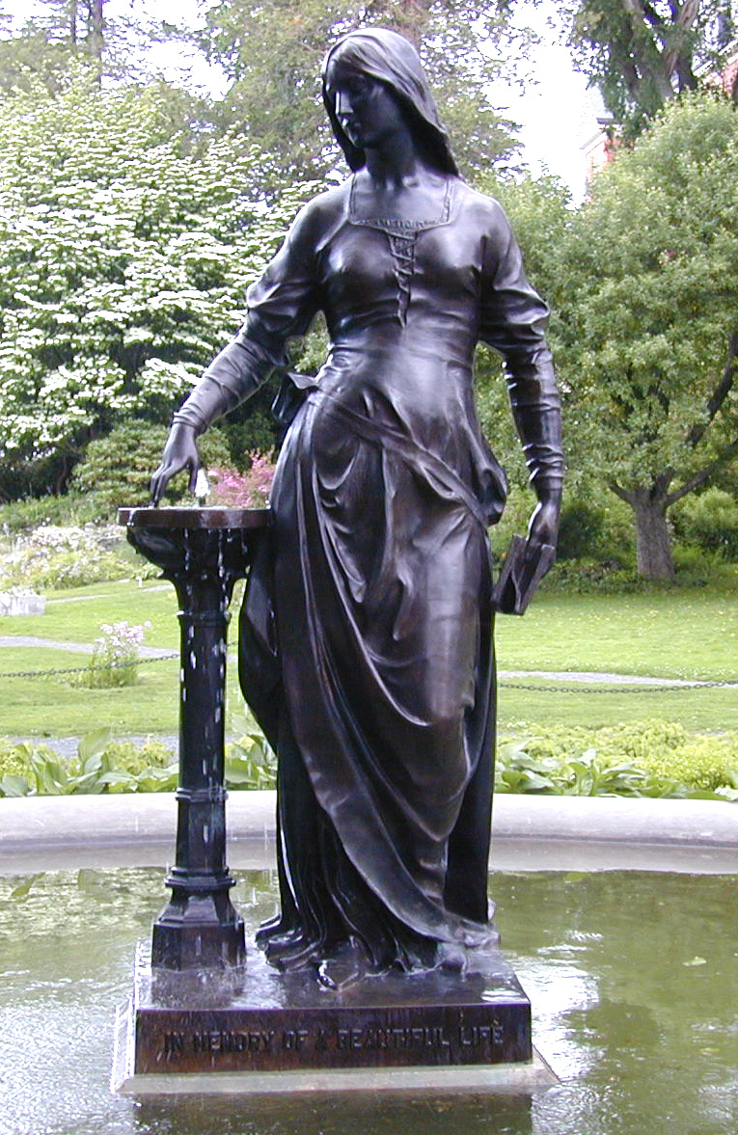

4. Initial exposure interferes with accurate perception
Mental Models
Blur size
128px
64px
32px
16px
8px
None

Slide 15
4. Initial exposure interferes with accurate perception
Longer exposure to ambiguous data makes people more confident in their initial model
This is true even if new data presents strong evidence that their model is wrong!
Important: need to be intentional when we design, because incremental information can be misleading
Mental Models
Anyone remember what we talked about last time that related to exactly this?

Slide 16
The good:
Well-tuned mental models let us process information quickly
Frees up more processing power to synthesize information
The bad:
People (esp. experts) tend not to notice information that contradicts their mental model
A “fresh pair of eyes” can be beneficial
The ugly:
Mental models are unavoidable: everyone has them, and they’re all different
Key: be aware of how mental models form, how they shape perception, and how to support (or challenge) them
Mental Models

Slide 17

What is perception?

Slide 18

Visual perception (def.)
the (sometimes imperfect)
process by which we
detect and interpret
visual signals

Slide 19
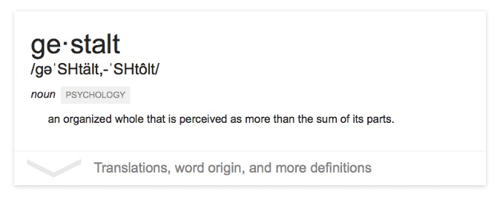
The “gestalt effect”
Our brain’s ability to generate whole forms, instead of just collections of unrelated elements

Slide 20




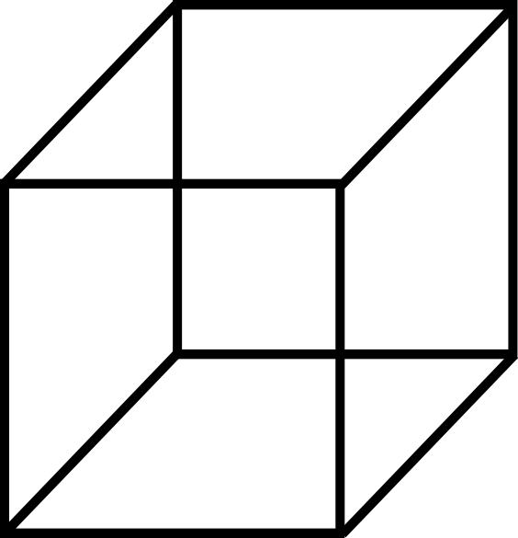
Emergence
Reification
Multistability
Invariance
Gestalt effects
Demonstration of reification in perception from Lehar S. (2003) The World In Your Head, Lawrence Erlbaum, Mahwah, NJ. p. 52, Fig. 3.3
Demonstration of invariance in perception from Lehar S. (2003) The World In Your Head, Lawrence Erlbaum, Mahwah, NJ. p. 53, Fig. 3.5
Life Magazine: 58;7 1965-02-19, p 120. Photographer: Ronald C James
Notes:
Reification – we prefer complete shapes, so we fill in the gaps between elements to complete the image
Emergence – See the big picture first, connect small parts into a big picture
Multistability – Many ways to interpret, but only see one at a time; front is back, front is front, diamond in middle
Invariance – see basic shapes as identical regardless of transformations

Slide 21
What does this mean for visualization?
Question: what makes all this mental model stuff useful to us (designers and readers of data)?
Answer: in order to understand how people interpret and make sense of data, we need to know what cues they’re picking up on – and how to situate those cues within a larger framework
6 “Laws of Grouping”

Slide 22
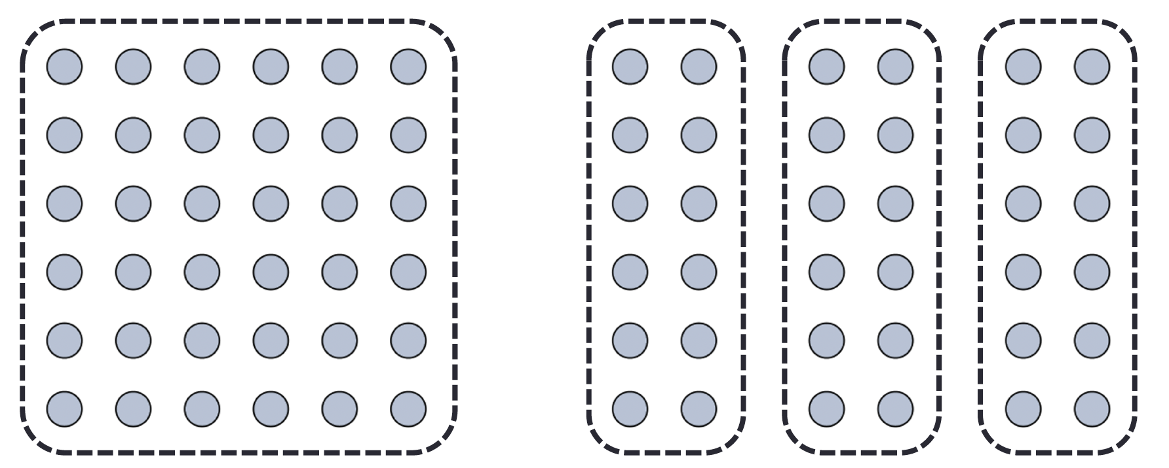
We interpret objects that are close to each other as a group
Law of Proximity

Slide 23
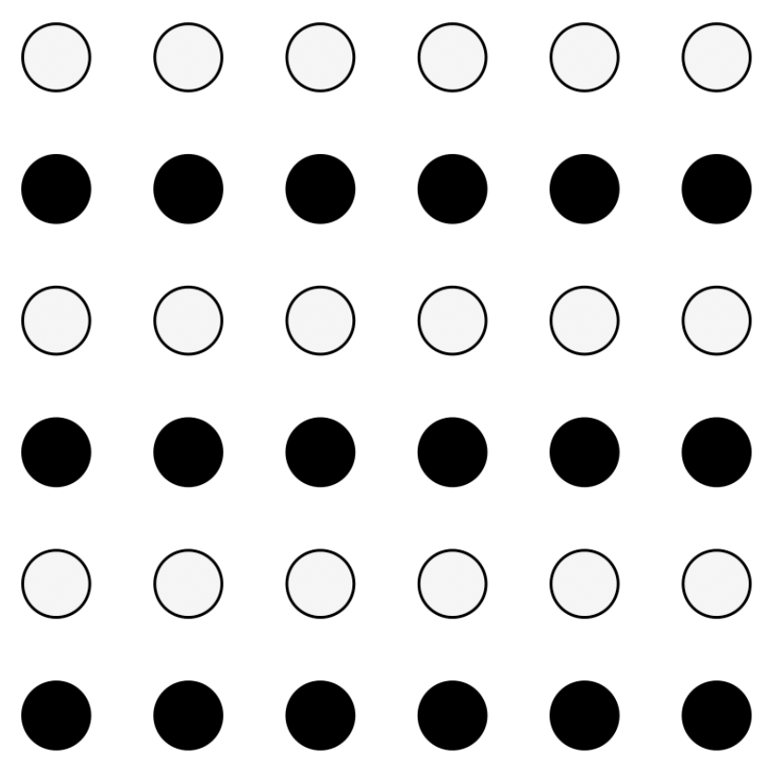
We interpret objects that are visually similar to each other as a group
Law of Similarity
“grey dots”
“black dots”

Slide 24

When parts of a picture are missing, we fill in the visual gap
Law of Closure

Slide 25
Law of Symmetry
We perceive objects as being symmetrical, arranged around a center point
law of proximity
[ ] { } [ ]
law of symmetry + law of similarity

Slide 26
We group objects that we perceive to be moving along the same path
Law of Common Fate

Slide 27
We tend to group objects along the smoothest path
Law of Continuity

Slide 28

Break into teams of 3
Choose a visualization from the Tableau Vis of the Day collection: https://public.tableau.com/app/discover/viz-of-the-day
Goal: identify as many examples of the Laws of Grouping (Gestalt Principles) in action in your sample visualization as you can
Let’s Practice
proximity
similarity
closure
[ ]
symmetry
common fate
continuity

Slide 29
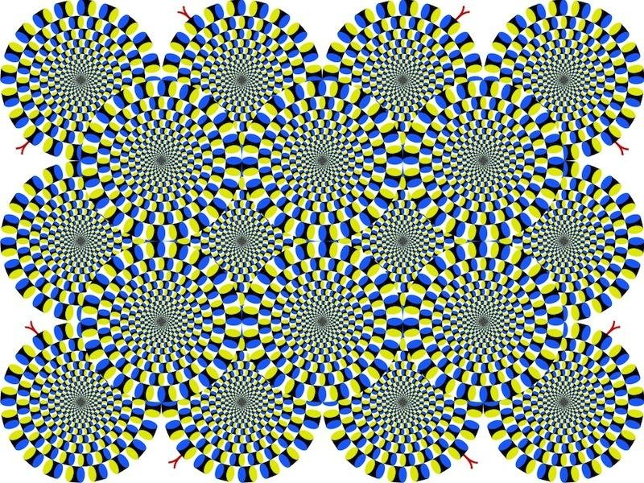
Do you see movement?

Slide 30
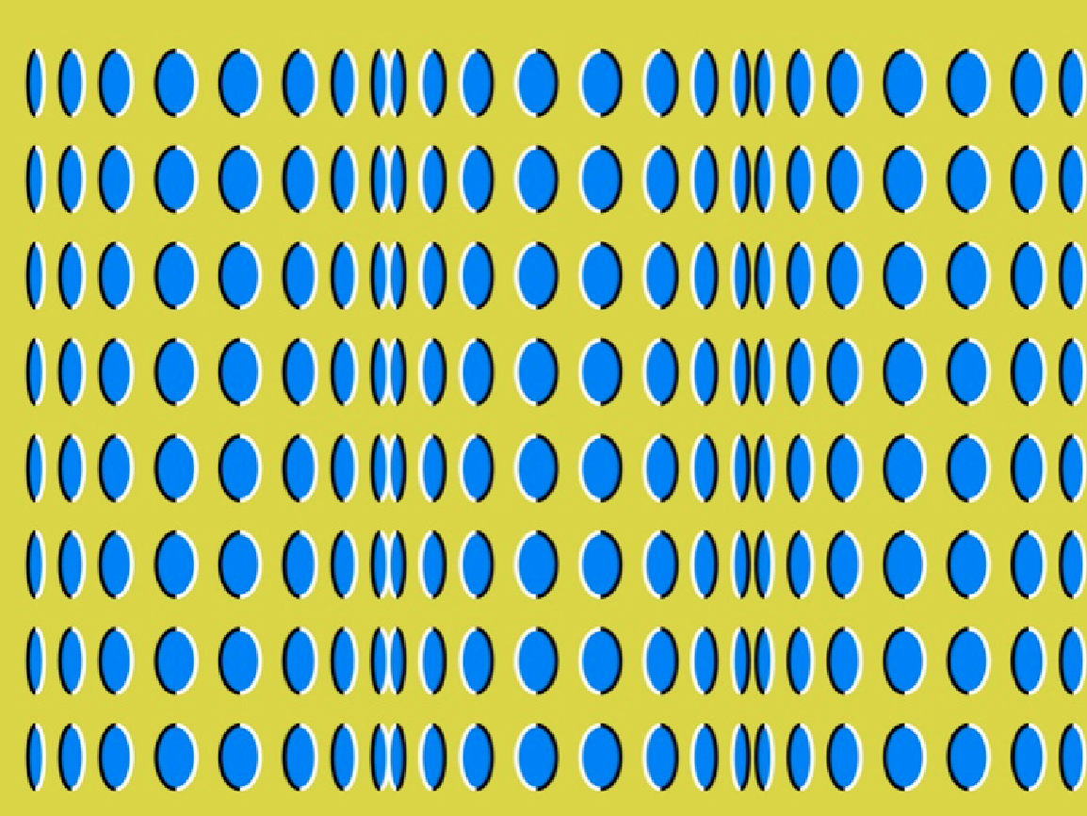
Do you see movement?

Slide 31
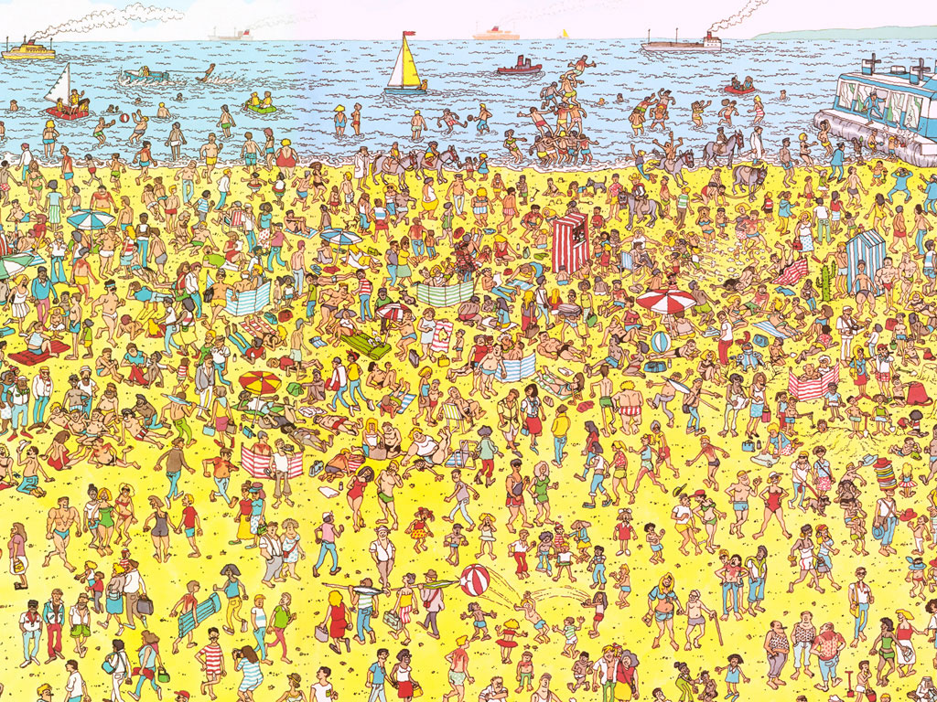
Some things are processed slowly
Visual perception

Slide 32
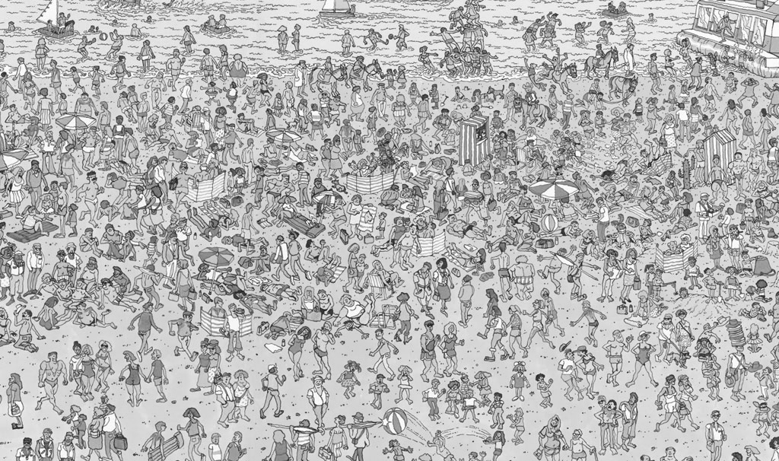
Others are incredibly fast
Visual perception

Slide 33
Fast = “pre-attentive processing”
Visual perception
Things that happen in <200ms of visual stimulation
Performed in parallel across the entire visual field
Example…
Notes:
Flash image on next screen

Slide 34
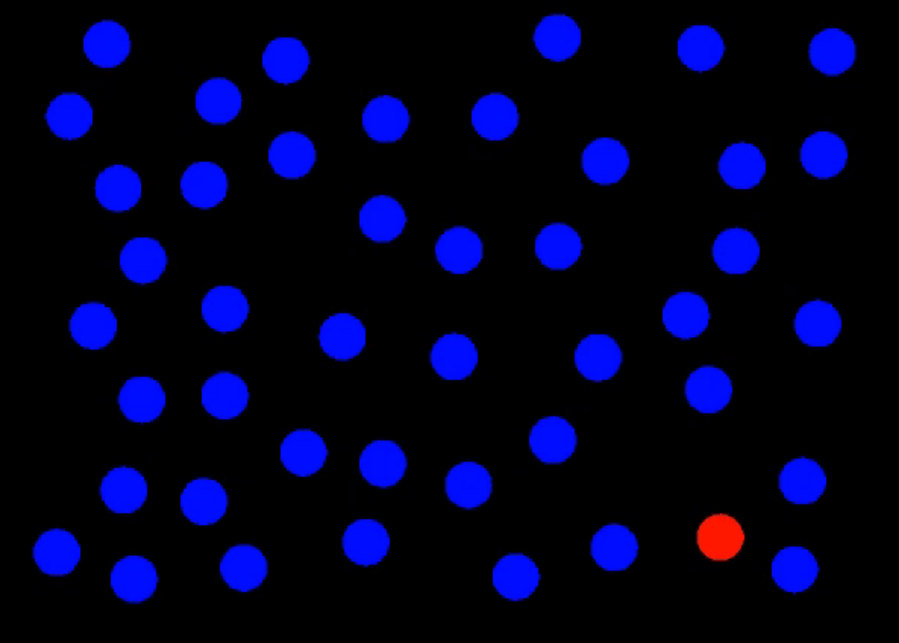
Perception: Pre-attentive Processing

Slide 35

What did you see?
Perception: Pre-attentive Processing
Notes:
Clocked my spacebar double-tap ability at about 80ms on average.
Without knowing what you were going to see, you likely attuned to the red dot in the field of blue dots.
This is the power of preattentive processing.

Slide 36
Pre-attentive processing
“An understanding of what is processed pre-attentively is probably the most important contribution that visual science can make to data visualization” (Ware, 2004, p. 19)

Slide 37
Pre-attentive processing facilitates:
Target detection (presence or absence)
Boundary detection / grouping
Region tracking
Counting and estimation
Notes:
Now I’m going to flash an image on the screen

Slide 38
Pre-attentive processing facilitates:
Target detection (presence or absence)
Boundary detection / grouping
Region tracking
Counting and estimation
On the next slide I want you to count how many zeros you see as fast as you can. Raise your hand (do not shout the number) when you have the answer.
Notes:
Now I’m going to flash an image on the screen

Slide 39
Attentive counting
1281768756138976546984506985624982826762
9809858458224519856458945098459985943585
9891330249945959595772564675750678974567
8845789819821677654876364968560912949686
How many zeros are there?
Notes:
Same on next slide but threes

Slide 40
Attentive counting
We’ll do the same on the next slide for threes.
Notes:
Same on next slide but threes

Slide 41
Pre-attentive counting
1281768756138976546984506985604982826762
9809858458224509856458945098450980943585
9091030209905959595772564675050678904567
8845789809821677654876364908560912949686
How many threes are there?

Slide 42
Pre-attentive processing for visualization
Question 1: how do we (vis designers) use pre-attentive processing to our advantage?
Question 2: what do we need to watch out for?

Slide 43
Pre-attentive processing for visualization
There’s only one instance of something on each of the next slides. What is it?

Slide 44
Pre-attentive processing: color (hue)

Slide 45
Pre-attentive processing: shape (curvature)

Slide 46
Pre-attentive processing: shape + color?

Slide 47
Discussion: what’s going on here?
Answer: this is called “conjunction”
If you search for red things, you get a bunch of red circles (as well as the red triangle).
Similarly, if you search for search for triangles, you get a bunch of blue triangles (as well as the red triangle).
Either way, you have to search through them all one by one!

Slide 48
Whatever draws our eyes draws our attention
This can be useful
It can also be problematic:
Pre-attentive processing for visualization

Slide 49

Ex. flicker can cause change blindness
Pre-attentive processing for visualization: The downsides
Notes:
What is changing?

Slide 50


Can you see it now?
Pre-attentive processing for visualization: The downsides
Notes:
Not only is this comparison easier, but if we now go back to the original flickering image, you won’t have the same problem – you can’t “unsee” the answer.

Slide 51
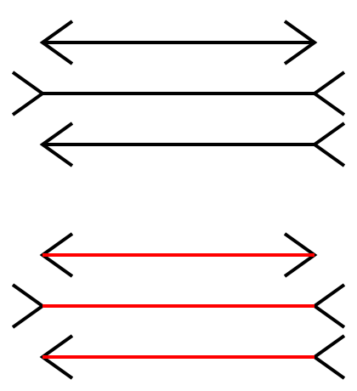
Sometimes gestalt & pre-attention compete
Pre-attentive processing for visualization: The downsides
Notes:
Are all the lines that same length? (Yes!)

Slide 52

Sometimes gestalt & pre-attention compete
Pre-attentive processing for visualization: The downsides
Notes:
Looks wavey purely because your brain wants to group together the similar colors
Actually, everything is a right angle

Slide 53
Okay, what about attentive processing?
Attentive processing

Slide 54
Magnitude estimation
Attentive processing
Question: How much bigger is the lower bar?
Answer: 2x

Slide 55
Magnitude estimation
Attentive processing
Question: How much bigger is the right square?
Answer: 4x

Slide 56
Magnitude estimation
Attentive processing
Question: How much bigger is the left cube?
Answer: 27x

Slide 57
“Apparent” magnitude
Attentive processing
What does this imply for using length vs area vs volume to represent data?
Length
estimate
correctly
Area
under-
estimate
Actual
perfect correspondence
Volume
way under-
estimate
Perceived
http://makingmaps.net/2007/08/28/perceptual-scaling-of-map-symbols/

